Slide 1
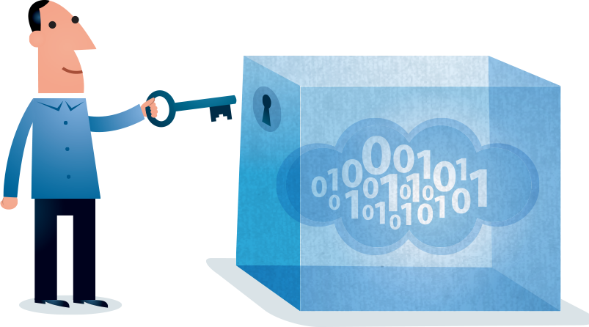
Personal Digital Archiving Train-the-Trainer Workshop
July 31, 2014

Slide 2
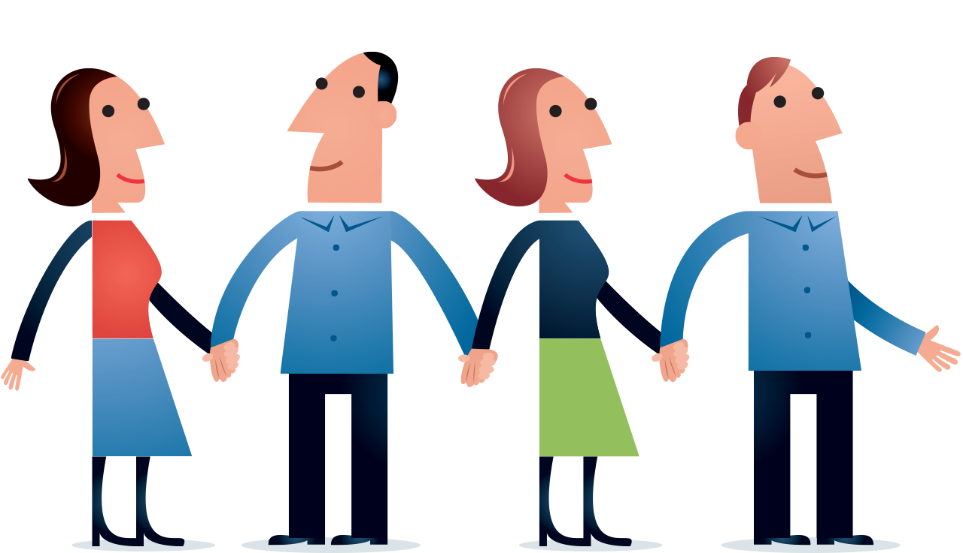
Brought to you by:
The Society of Georgia Archivists The Georgia Library Association The Atlanta Chapter of ARMA

Slide 3
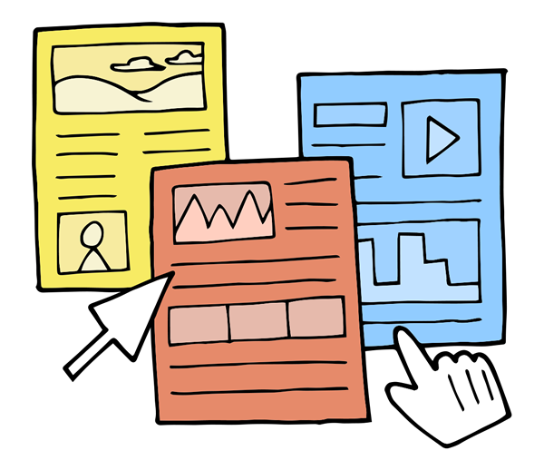
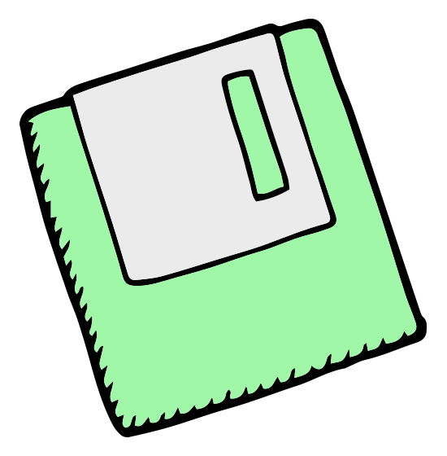
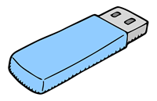
Instructors:
Oscar Gittemeier, Youth Services Librarian, Atlanta-Fulton Public Library, East Atlanta Branch
Wendy Hagenmaier, Digital Collections Archivist, Georgia Tech Archives
Michelle Kirk, Records Manager, VP Corporate Records and Information Management, SunTrust Banks, Inc.

Slide 4
Part I:
The What and the Why of Personal Digital Archiving

Slide 5
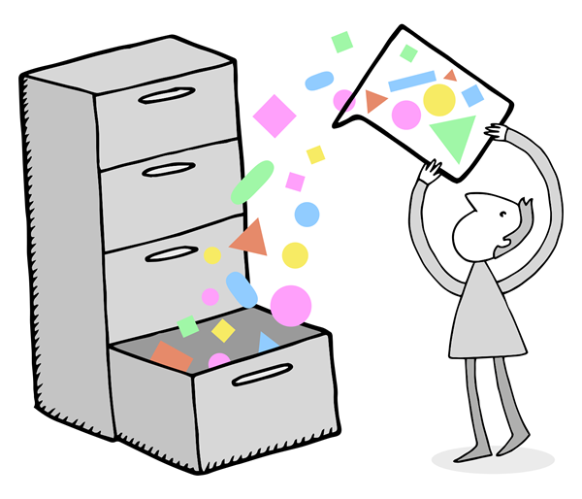
Personal Digital Archiving
What is retention?
What is archiving?
Why should we care about archiving our personal records?

Slide 6
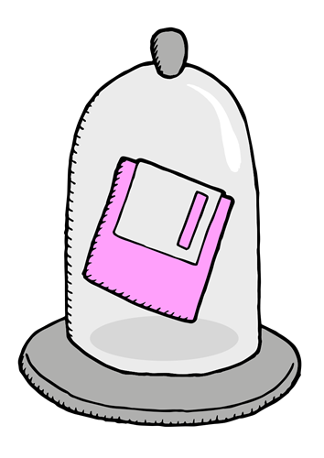
What Qualifies as a Personal Record?
Records are things constituting pieces of evidence about the past, especially an account of an act or occurrence kept in writing or some other permanent form (Google Dictionary)
Personal vs. Business Records
An organization owns all its records that are created as evidence of its business transactions
Likewise, individuals own records of their personal business transacted, and any other records created for historical purposes

Slide 7
Record Identification and Inventory
Questions to ask yourself when determining if something is a record:
Might I need this to substantiate a claim?
Is there a legal or financial/tax reason why I should preserve this?
Does this have intrinsic or historical value which makes me want to keep it indefinitely?
Make a list of the records
Group into records and non-records
Determine how long to keep the records

Slide 8
Types and Retention of Personal Records
Record Type | Examples | Retention Period (how long to preserve)
Financial | Loan Payoffs, Tax Returns, Cancelled Checks, Bank Statements, Paycheck Stubs, Investment Statements, Medical Bills | Varies
Legal | Wills, Trust Documents, Marriage Licenses, Adoption Papers, Death Certificates, Deeds | Varies
Medical | Test Results | Indefinite
Historical | Photos, Videos, Audio, Scanned or “born digital” Documents | Indefinite
See the handouts for great resources on how long different types of personal records should be retained.

Slide 9
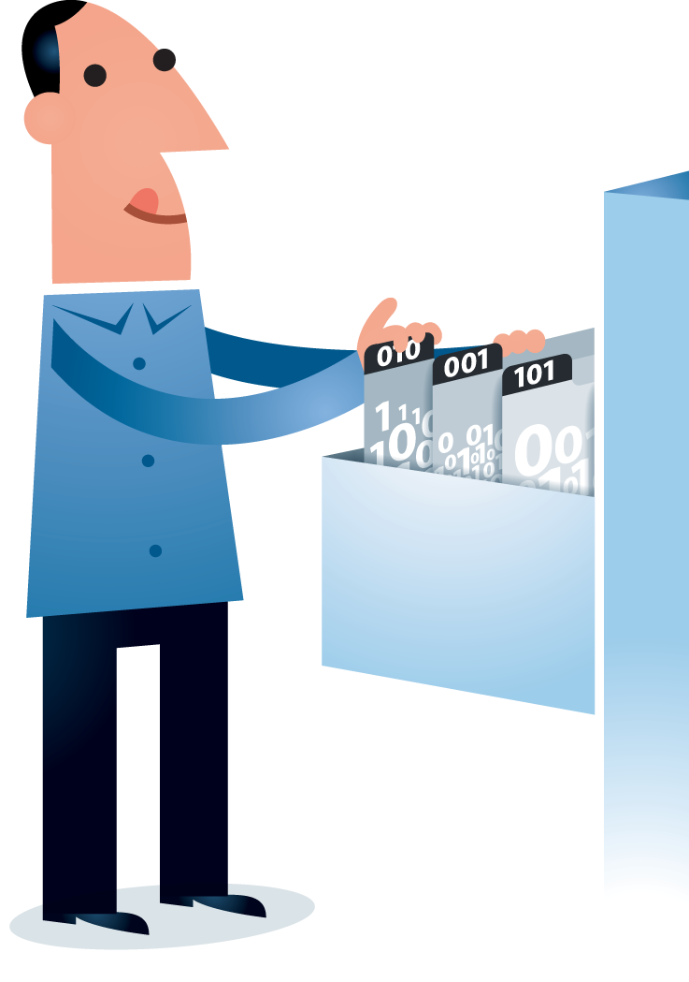
Formats of Records
Records are increasingly being “born digital”
Most records can be preserved digitally instead of in paper format
It’s important to understand that unlike paper records, long term digital records need special treatment

Slide 10
Part II:
The Landscape of Personal Digital Records

Slide 11
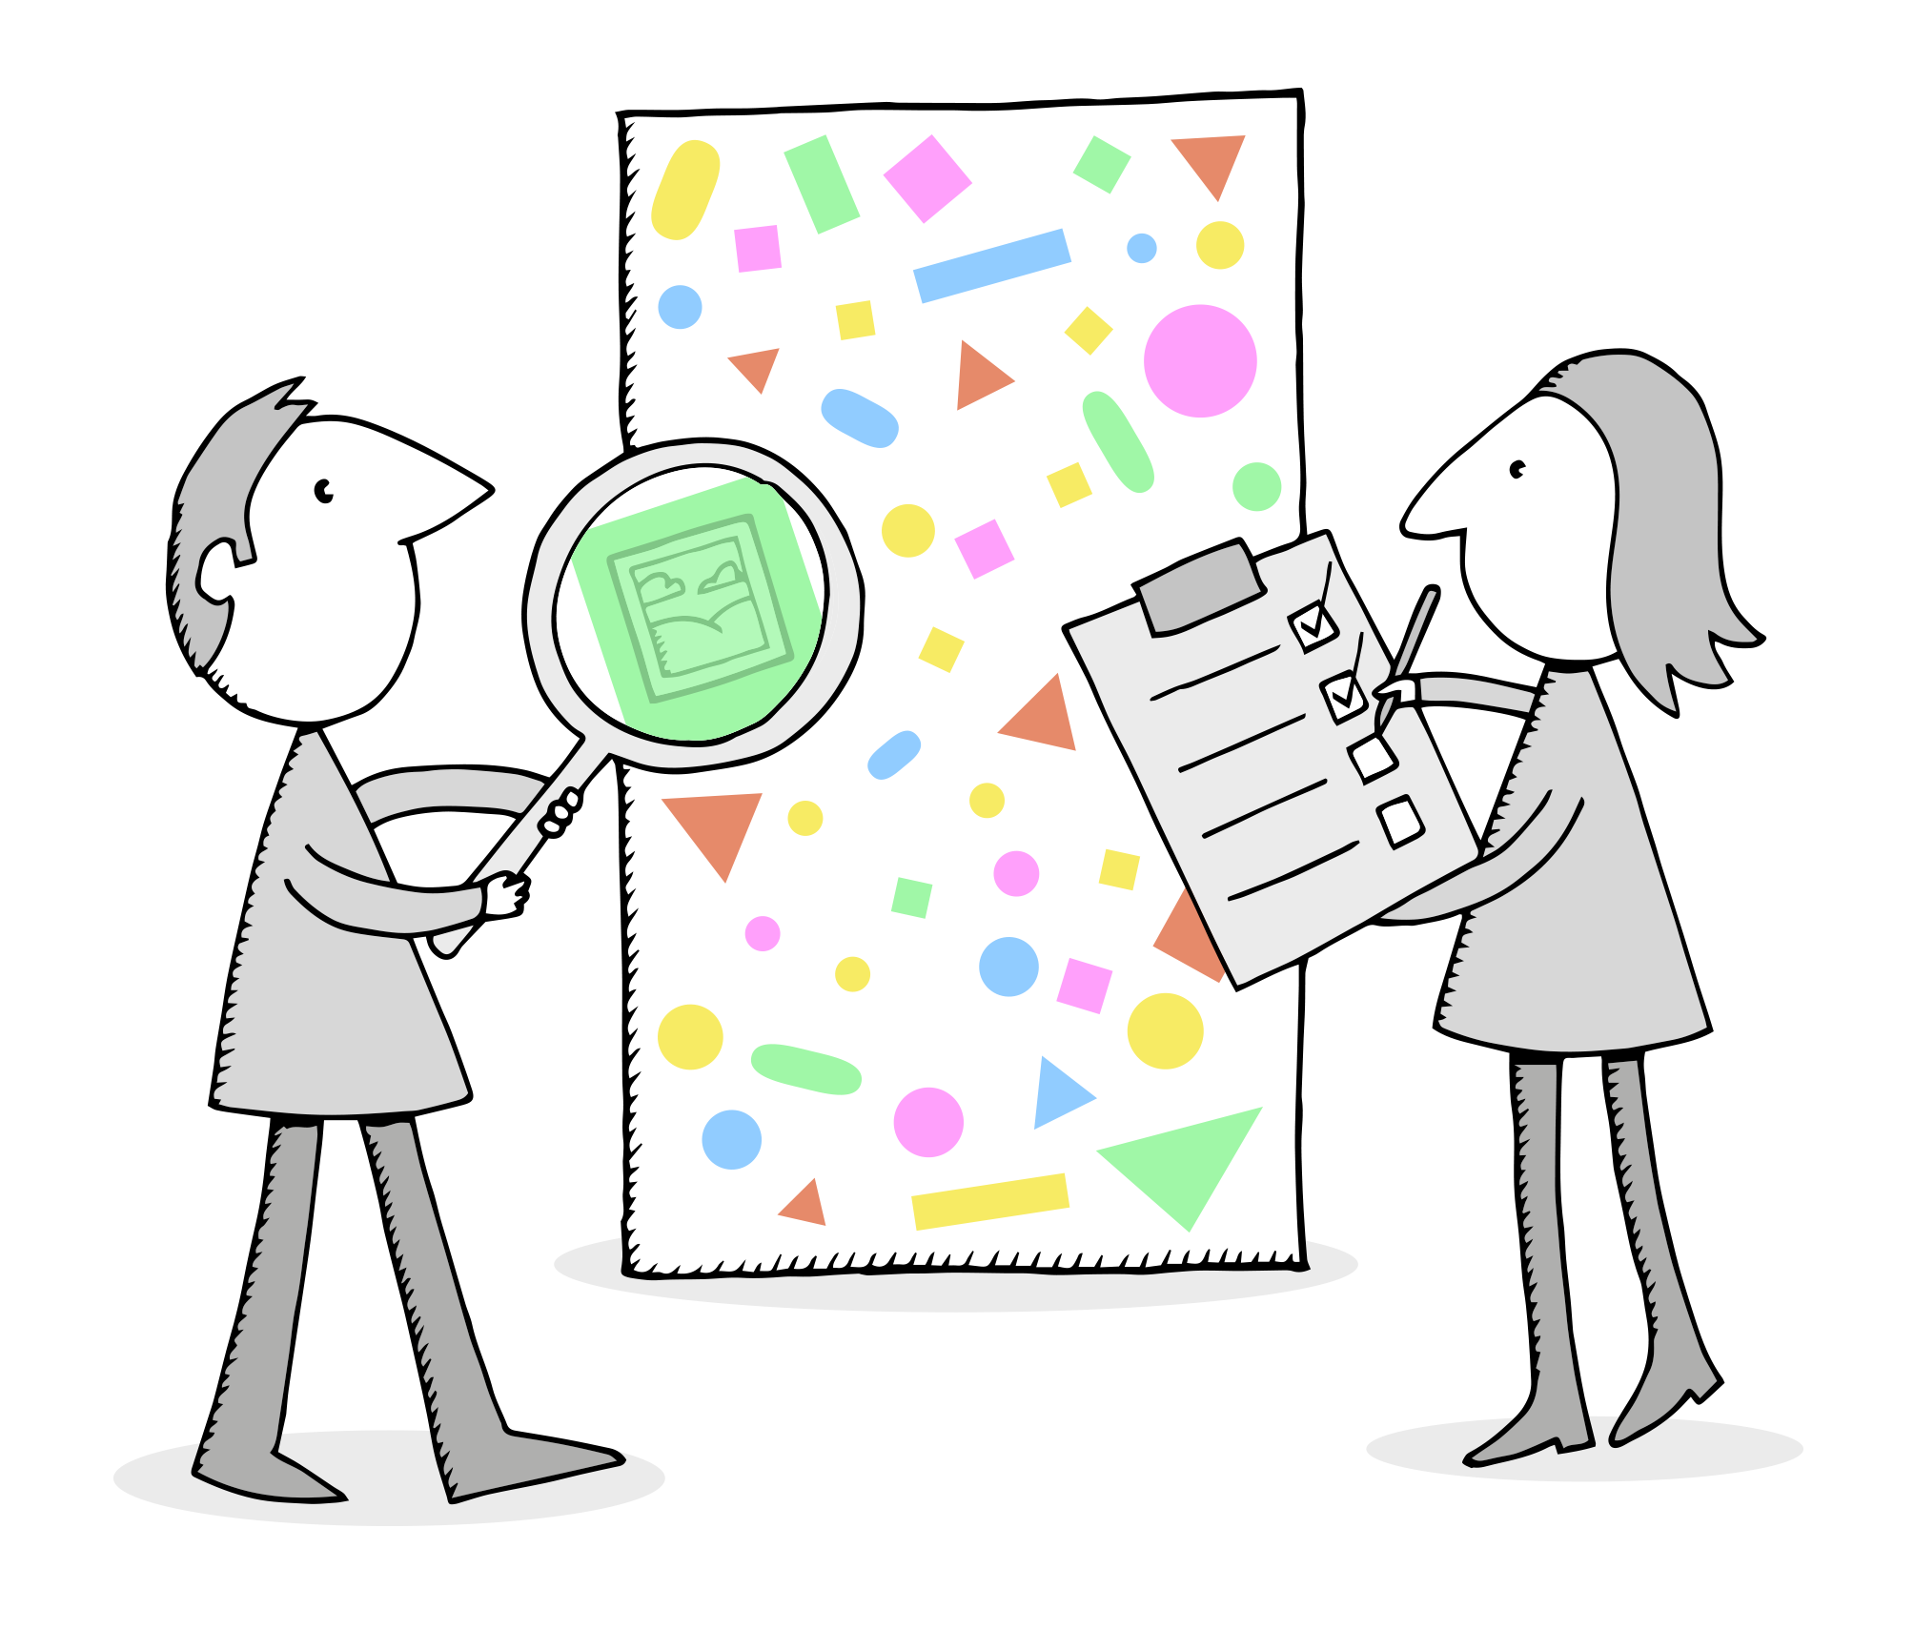
“Instructions for Future Interaction”
“Digital objects are sets of instructions for future interaction.”
(Cal Lee, “Digital Forensics Meets the Archivist (And They Seem to
Like Each Other),” Society of Georgia Archivists Annual Meeting, 2012)
Digital records are rendered, represented, experienced
Think of digital records as interactions at various technical and social levels:
interactions between hardware and software
interactions between software and files
interactions among record creator, record steward, and record user
So, it’s important to understand the ecosystem of personal digital records

Slide 12
Personal Digital Records Ecosystem
 | LOCAL | OFFSITE
HARDWARE | Personal computer -Internal: CPU, RAM, motherboard, storage drive (magnetic, optical, or solid state), etc. -Peripheral: USB devices, keyboard, monitor, etc. Other devices: phone, camera, external drives, wearable devices, etc. | Remote servers & storage (including cloud)
SOFTWARE | Filesystem Operating System (Windows, OS X, Linux) Applications (MS Word, iMovie, Adobe Photoshop, AutoCAD, Firefox, etc.) | Web Applications (Gmail and Google Drive, DropBox, iCloud, Facebook, Twitter, Flickr, etc.)
DATA | Data & metadata intentionally created by user (image, video, document, code, etc.) Data & metadata created by system (log files, etc.) | Data & metadata intentionally created by user (tweet, image, video, document, code, etc.) Data & metadata created by system (log files, transactional data that assists with management of distributed systems, etc.)

Slide 13
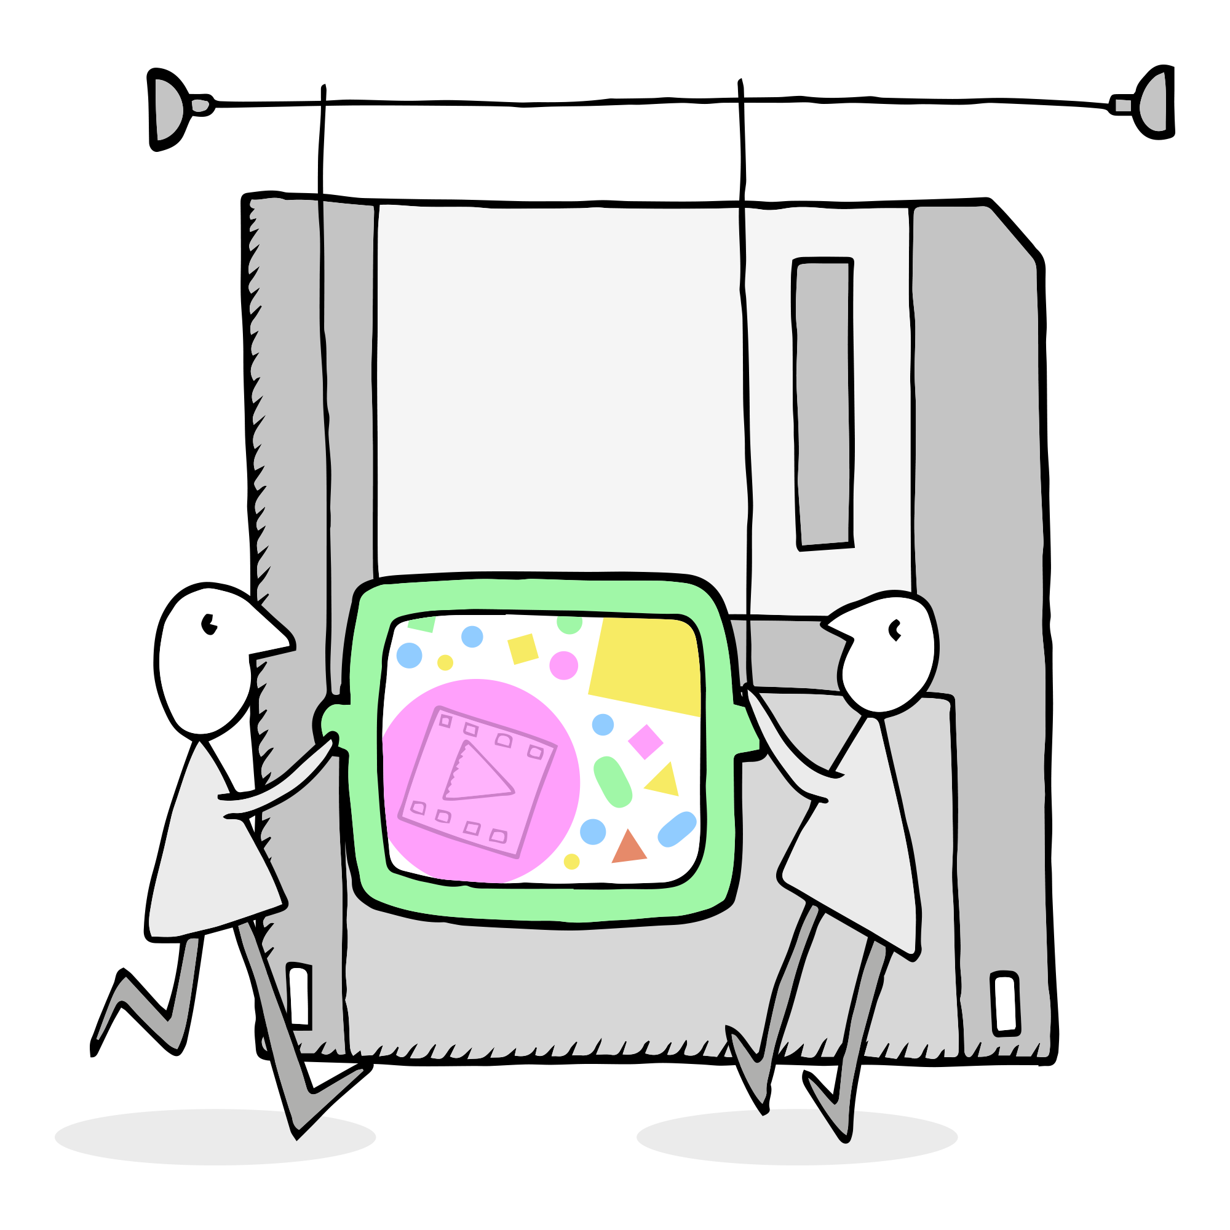
Multiple Ways to Represent a Digital Record
“Though computer systems maintain ‘an illusion of immateriality’...it is essential to recognize that digital objects are created and perpetuated through physical things (e.g. charged magnetic particles, pulses of light). Digital materials can be considered and encountered at multiple levels of representation, ranging from aggregations of records down to bits as physically inscribed on a storage medium...”
(Cal Lee, Kam Woods, Matthew Kirschenbaum, and Alexandra Chassanoff.
"From Bitstreams to Heritage: Putting Digital Forensics into Practice in Collecting Institutions.“)

Slide 14
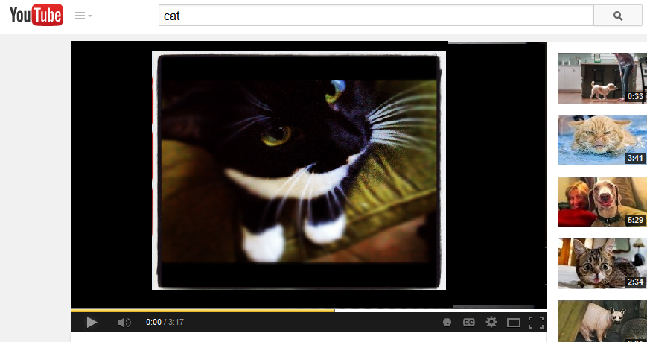
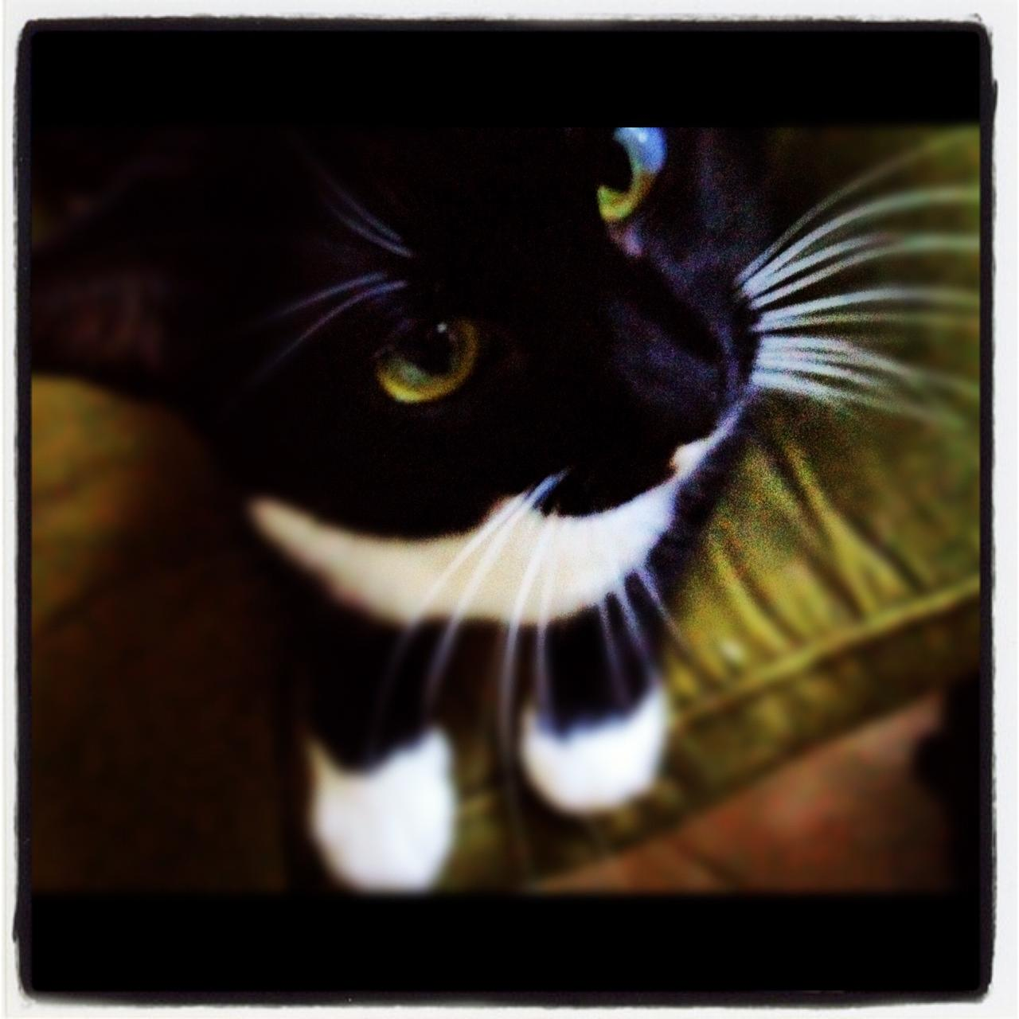
For Example, a Few Different Ways to Represent a Cat Video…
01100011 01100001 01110100 01110110 01101001 01100100 01100101 01101111
meowpurr

Slide 15
Part III:
Best Practices for Creating Personal Digital Records

Slide 16
Think Ahead
How will you be able to most easily find your records?
How will you be able to use your records at a later date?
If you can’t find them or you can’t open them, they are of no use to you!

Slide 17
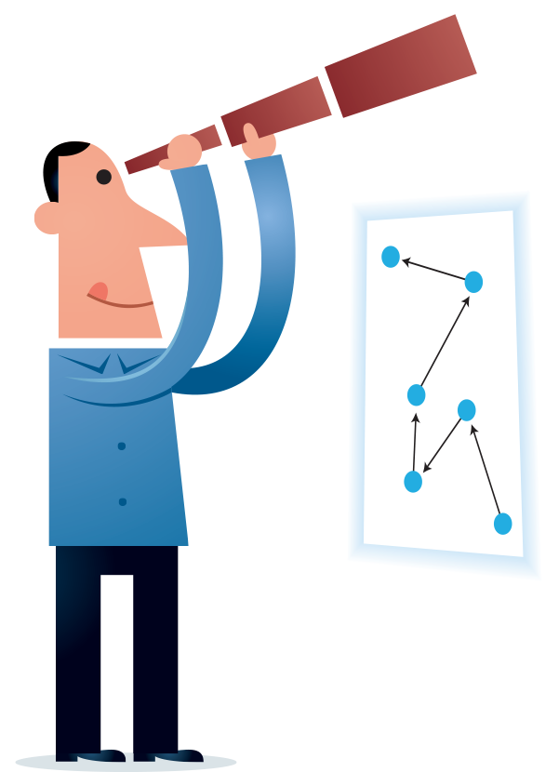
Findability
Things that can increase findability and factors that assist with this:
Ability to be able to find using a search tool
Metadata
Full Text Indexing
Intelligent and Standard file naming
Ability to find manually
Intelligent and Standard Organization
Intelligent and Standard file naming

Slide 18
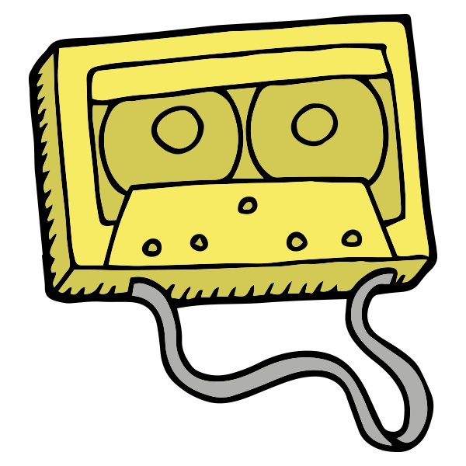
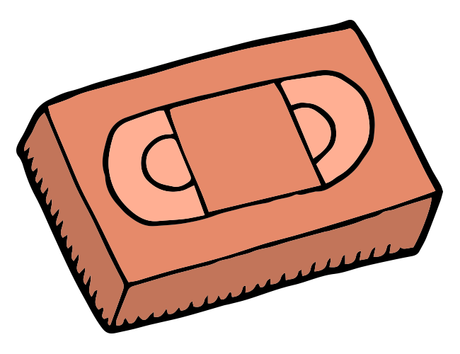
Usability
Will you be able to open and use your records 5 years from now? 10 years? 20 years?
Be mindful of the following:
File Formats
Storage Media
Storage Location

Slide 19
Part IV:
Ownership and Copyright of Personal Digital Records

Slide 20
Ownership and Copyright
Ownership | Copyright
Owning the bits you make | Having the exclusive right to reproduce, distribute, perform, display, or create derivatives of a digital record, and the exclusive right to authorize others to do so
Ownership and copyright don’t always go hand-in-hand

Slide 21
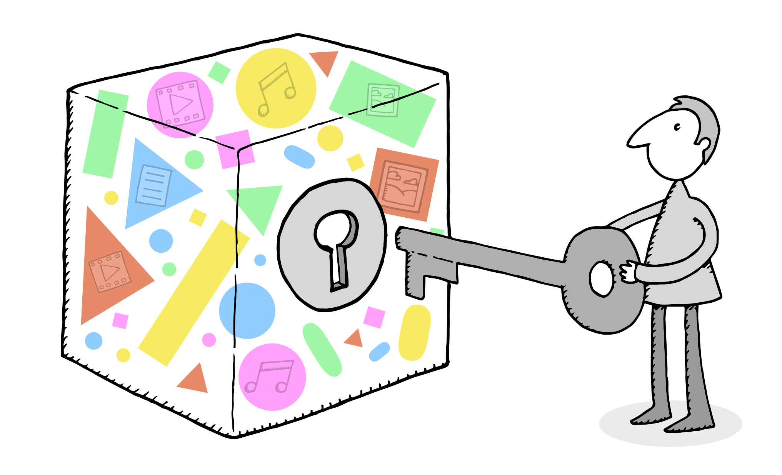
Copyright and Ownership Questions to Ask Yourself about the Digital Records You Create
Ownership | Copyright
Do you own the digital record? | Do you own copyright to the digital record?

Slide 22
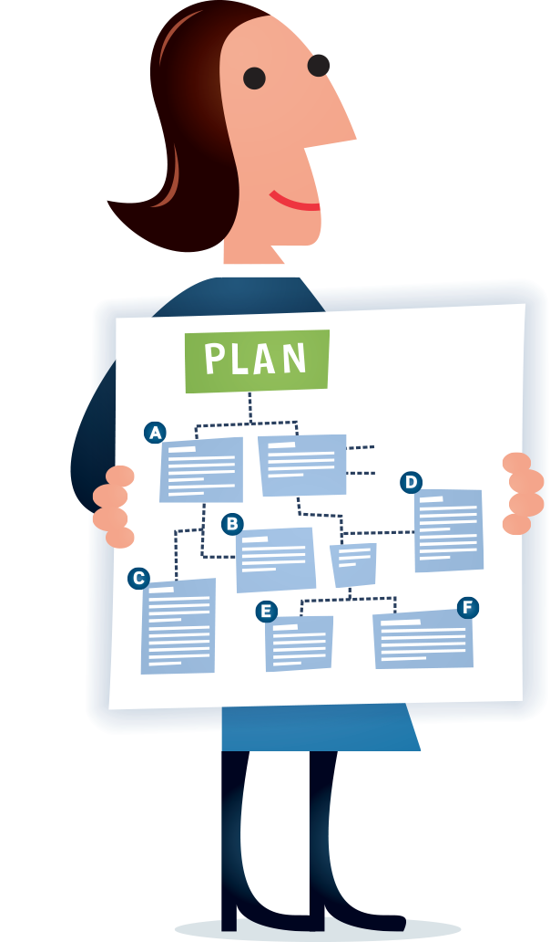
Be Proactive about Your Rights
How can you make proactive choices about the digital records you own and to which you own copyright?
Use a Creative Commons license standard: https://creativecommons.org/choose/
Check out the DPLA’s Getting it Right on Rights project: http://dp.la/info/about/projects/getting-it-right-on-rights/

Slide 23
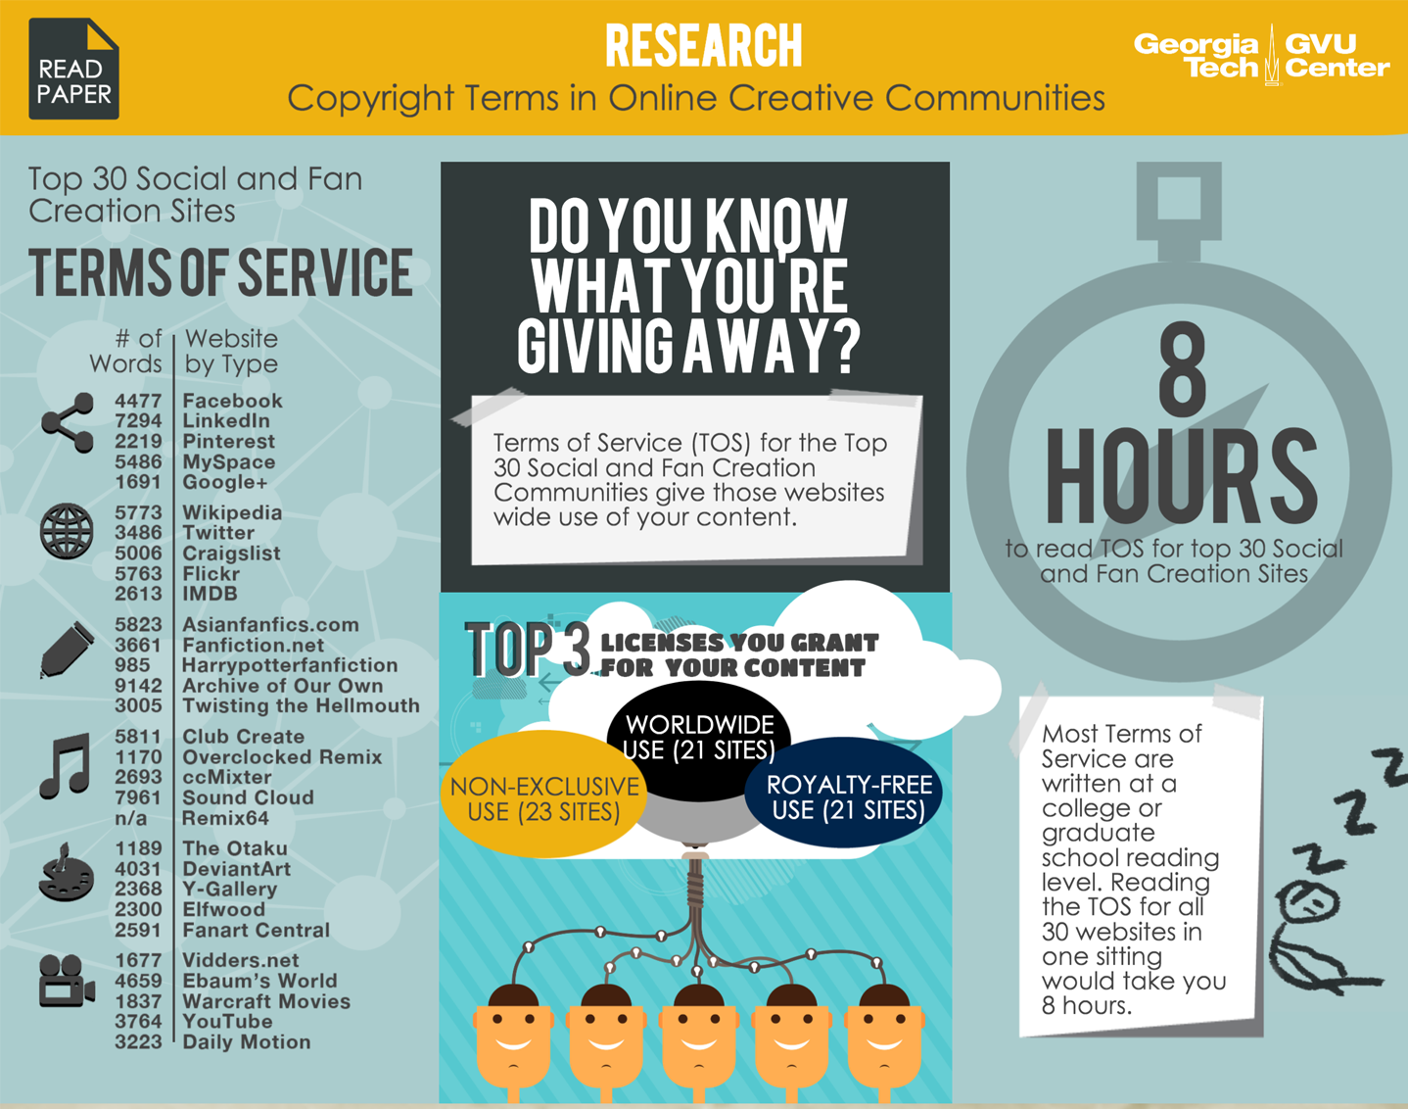
Be Proactive about Your Rights
Do you know what digital records you have licensed to another entity?
Pay close attention to terms of service and user agreements
Casey Fiesler and Amy Bruckman,
GVU Center at Georgia Tech

Slide 24
For Example…
Ownership | Copyright
Do you own the digital record? | Do you own copyright to the digital record?
A record you create with a local copy of purchased, copyrighted software (Photoshop, AutoCAD, etc.)
A record you create, share, and store using offsite/remote/web-based copyrighted software as a service (social media records, records in Google Drive, etc.)
Also ask yourself:
Have you licensed the record to another entity?
Will you own or have access to the software required to edit or view the record indefinitely?
Will you be able to preserve the record indefinitely?

Slide 25
Part V:
Privacy and Security of Personal Digital Records

Slide 26
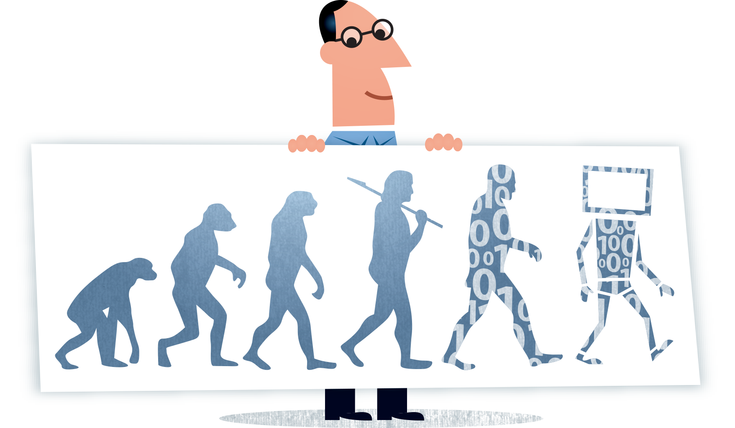
Digital = New Privacy and Security Challenges
The digital landscape introduces new privacy and security challenges and intensifies existing issues
Personal records have always contained private and personally identifying information, but technological factors and the sheer quantity of digital records can make it harder to delete or even know about the private information that exists in a digital record collection
Staying aware of the digital records you have and proactively managing them will empower you to deal with privacy and security challenges that might arise

Slide 27
Encryption
One tactic often used to protect privacy and security is encryption (using algorithms to transform digital records into formats that are intentionally harder to read)
Some types of encryption: application, operating system, storage system
Pros | Cons
Can enhance privacy and confidentiality | Can hinder your ability to maintain control over your records
Can protect the integrity and authenticity of a record | If you or someone in the future loses the encryption key
Can help you maintain control over your records | If software required to decrypt or render encrypted records becomes obsolete or unavailable

Slide 28
Part VI:
Best Practices for Storing Personal Digital Records

Slide 29
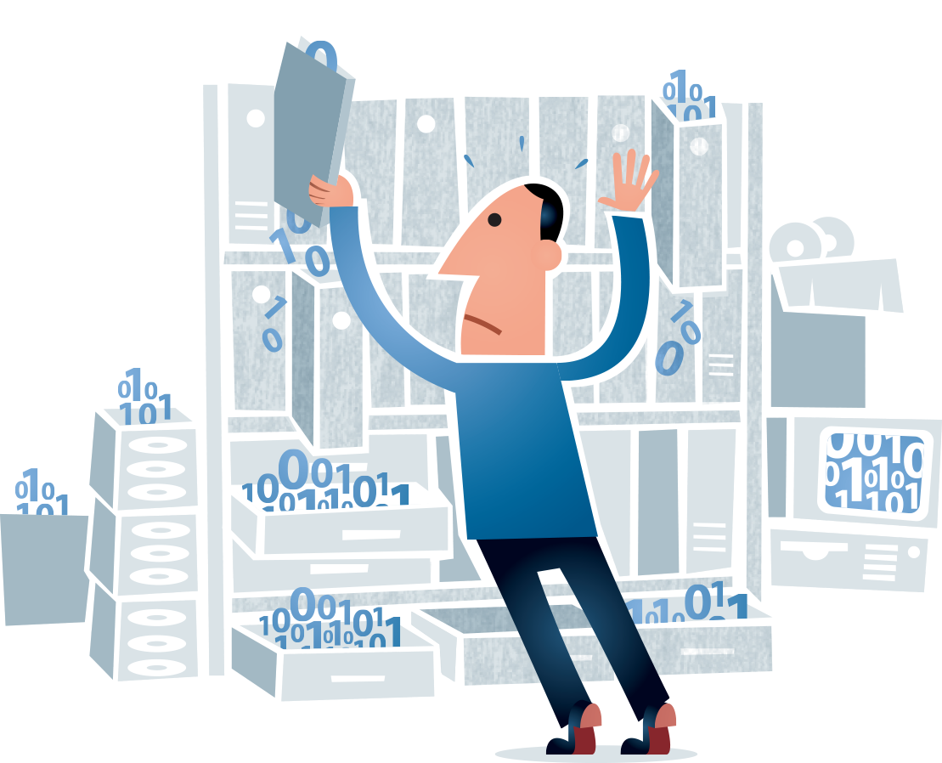
Storage Options
Cloud service
External storage
Personal server

Slide 30
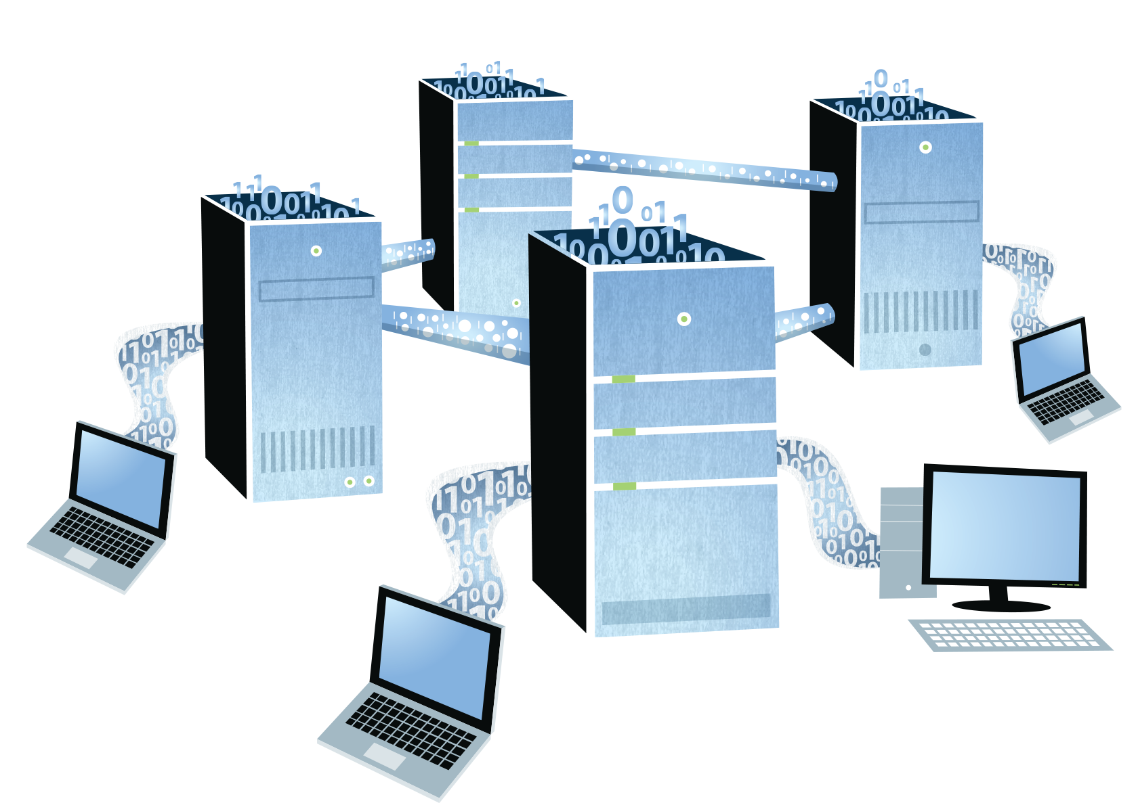
Cloud Storage
Your photos, documents, music, email, etc. are stored and managed on servers that belong to someone else

Slide 31
Cloud Storage: Examples
Google Drive - 15 GB Free Storage
Apple iCloud - 5 GB Free Storage
Dropbox - 2 GB Free Storage
Box - 5 GB Free Storage
Microsoft One Drive - 7 GB Free Storage
Amazon Cloud Drive - 5 GB Free Storage
Comparison of Cloud Services: http://en.wikipedia.org/wiki/Comparison_of_online_backup_services

Slide 32
Cloud Storage: Pros and Cons
Pros | Cons
Sync data from multiple devices and access data anywhere from any device | Security and privacy concerns
Provides backup and recovery of data | File type restrictions
Inexpensive storage option for small amounts of data | Companies and services are not permanent and can change

Slide 33
External Storage
Stores data outside of your computer, laptop, camera, phone, or other device

Slide 34
External Storage: Examples
External hard drive
USB flash drive, DVD, Blu-ray, CD (these are sometimes considered less desirable for preservation)
Options: http://www.pcworld.com/article/248921/need_more_storage_expand_with_external_drives.html

Slide 35
External Storage: Pros and Cons
Pros | Cons
You can store an unlimited amount of data outside of your device | Drives can be damaged or lost
Provides a backup for your data if your device is lost or damaged | Data can rot and decay over time
Cheaper than cloud storage | More expensive than an internal drive of equal capacity

Slide 36
Personal Server
Hardware and software that provide network service and centralized access to data

Slide 37
Personal Server: Examples
Dedicated Server
Virtual Private Server (VPS - Hosts data remotely)
Embedded Miniserver (ex. Raspberry Pi - Low cost, but slow)

Slide 38
Personal Server: Pros and Cons
Pros | Cons
Privacy and security | Upfront cost
Centralized storage for all devices | Must manage software and security
Access files remotely | Maintenance: power outages and damage
Personal Server Pros and Cons: https://citizenweb.is/guide/srv/1-why
PersonalServer.com: https://www.personalserver.com/web/en/home

Slide 39
Part VII:
Best Practices for Access and Ongoing Management of Personal Digital Records

Slide 40
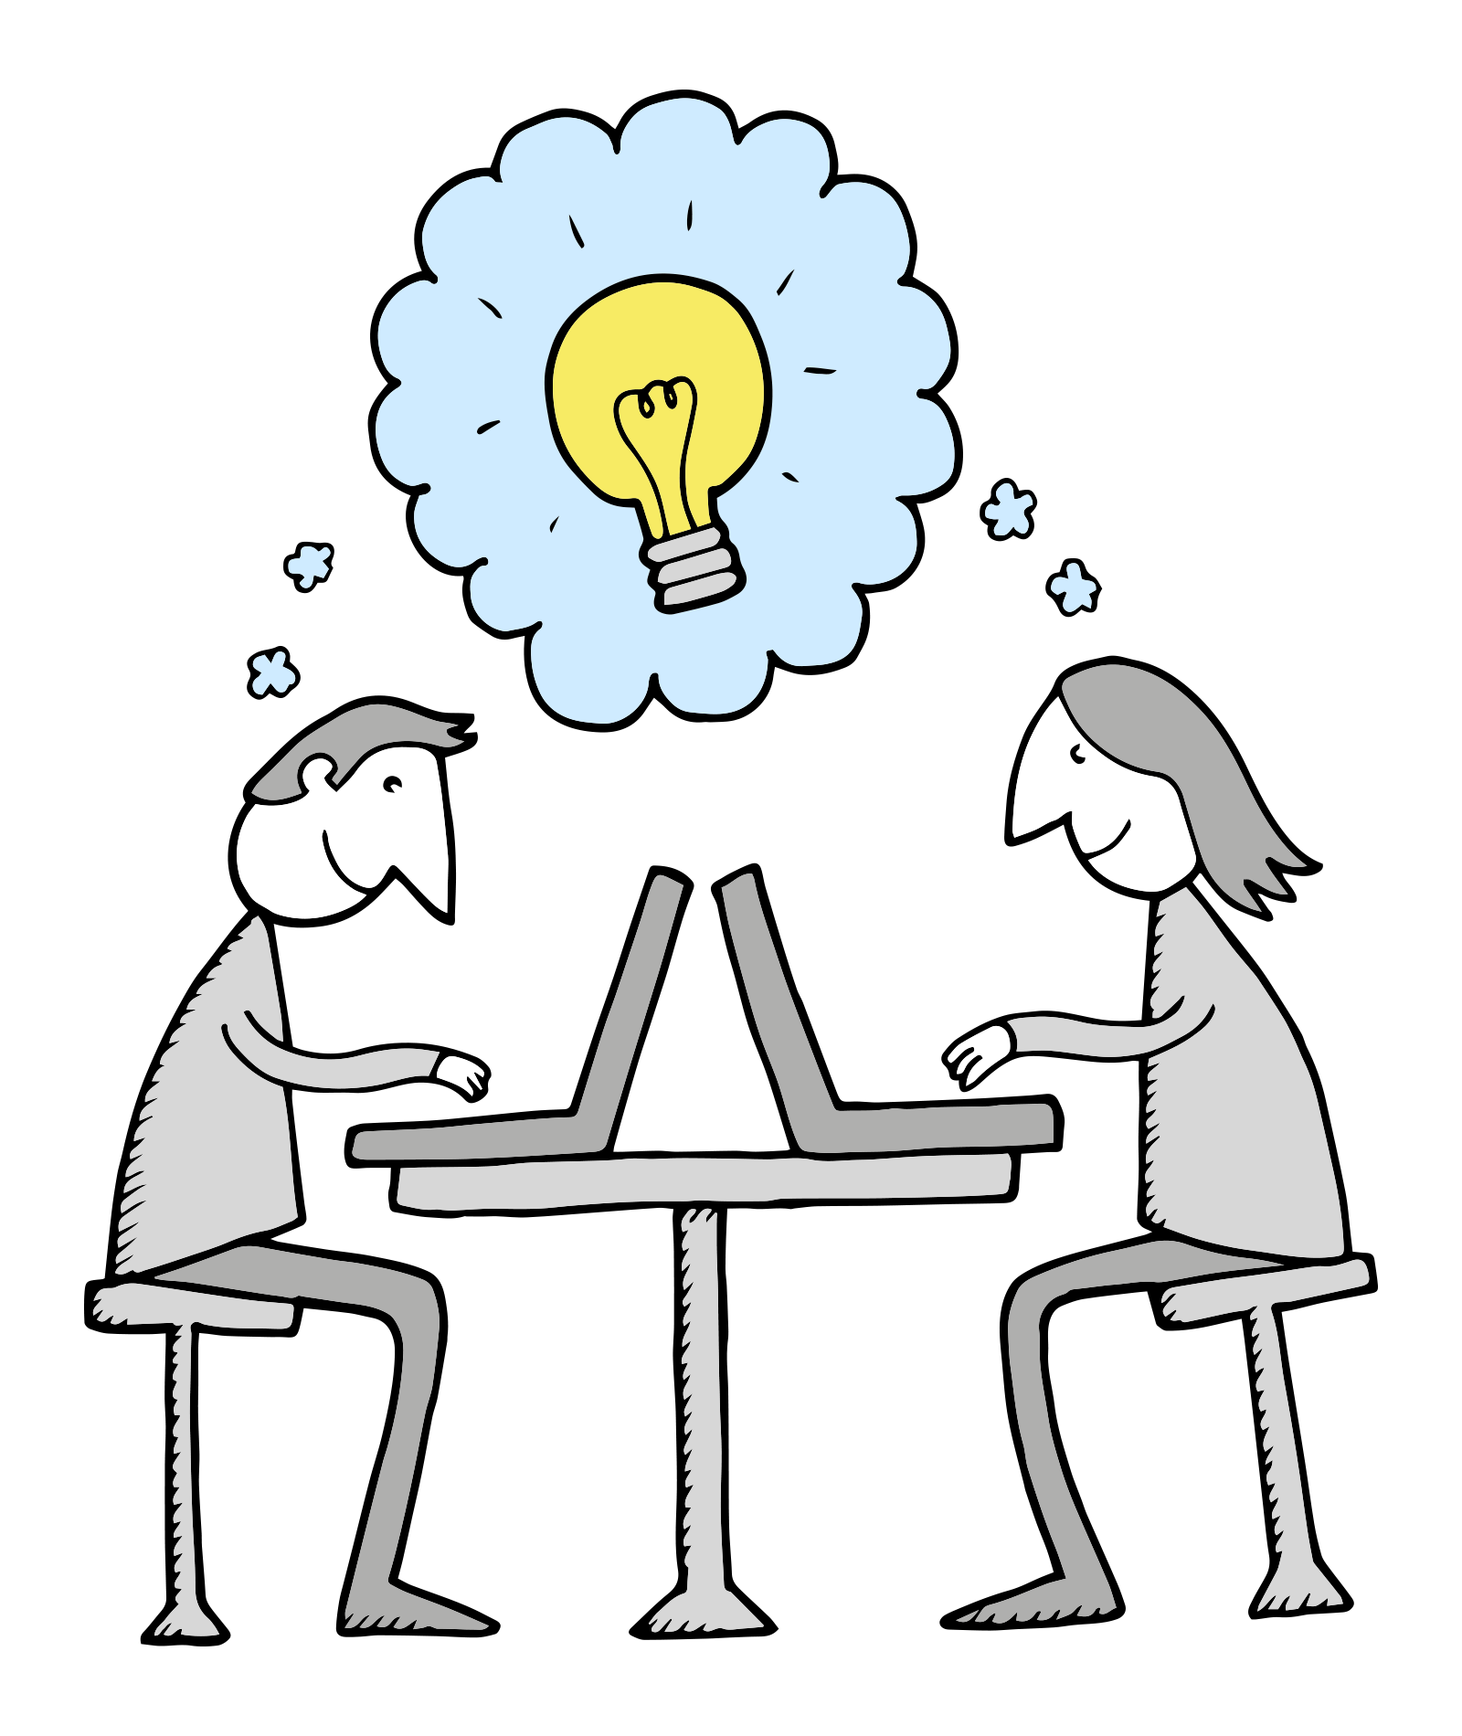
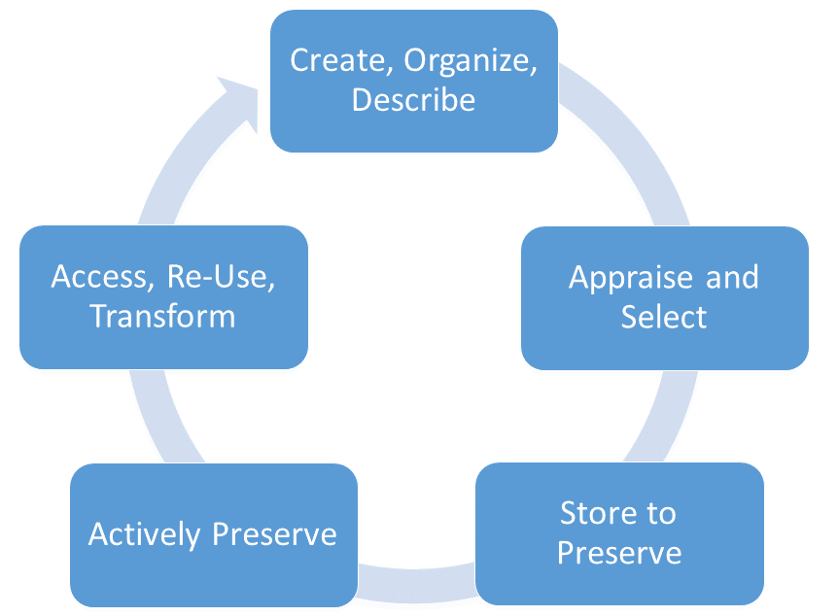
Lifecycle of Digital Stewardship

Slide 41
Store to Preserve
Archivematica Format Policies: https://www.archivematica.org/wiki/Format_policies
Library of Congress Recommended Format Specifications: http://www.loc.gov/preservation/resources/rfs/

Slide 42
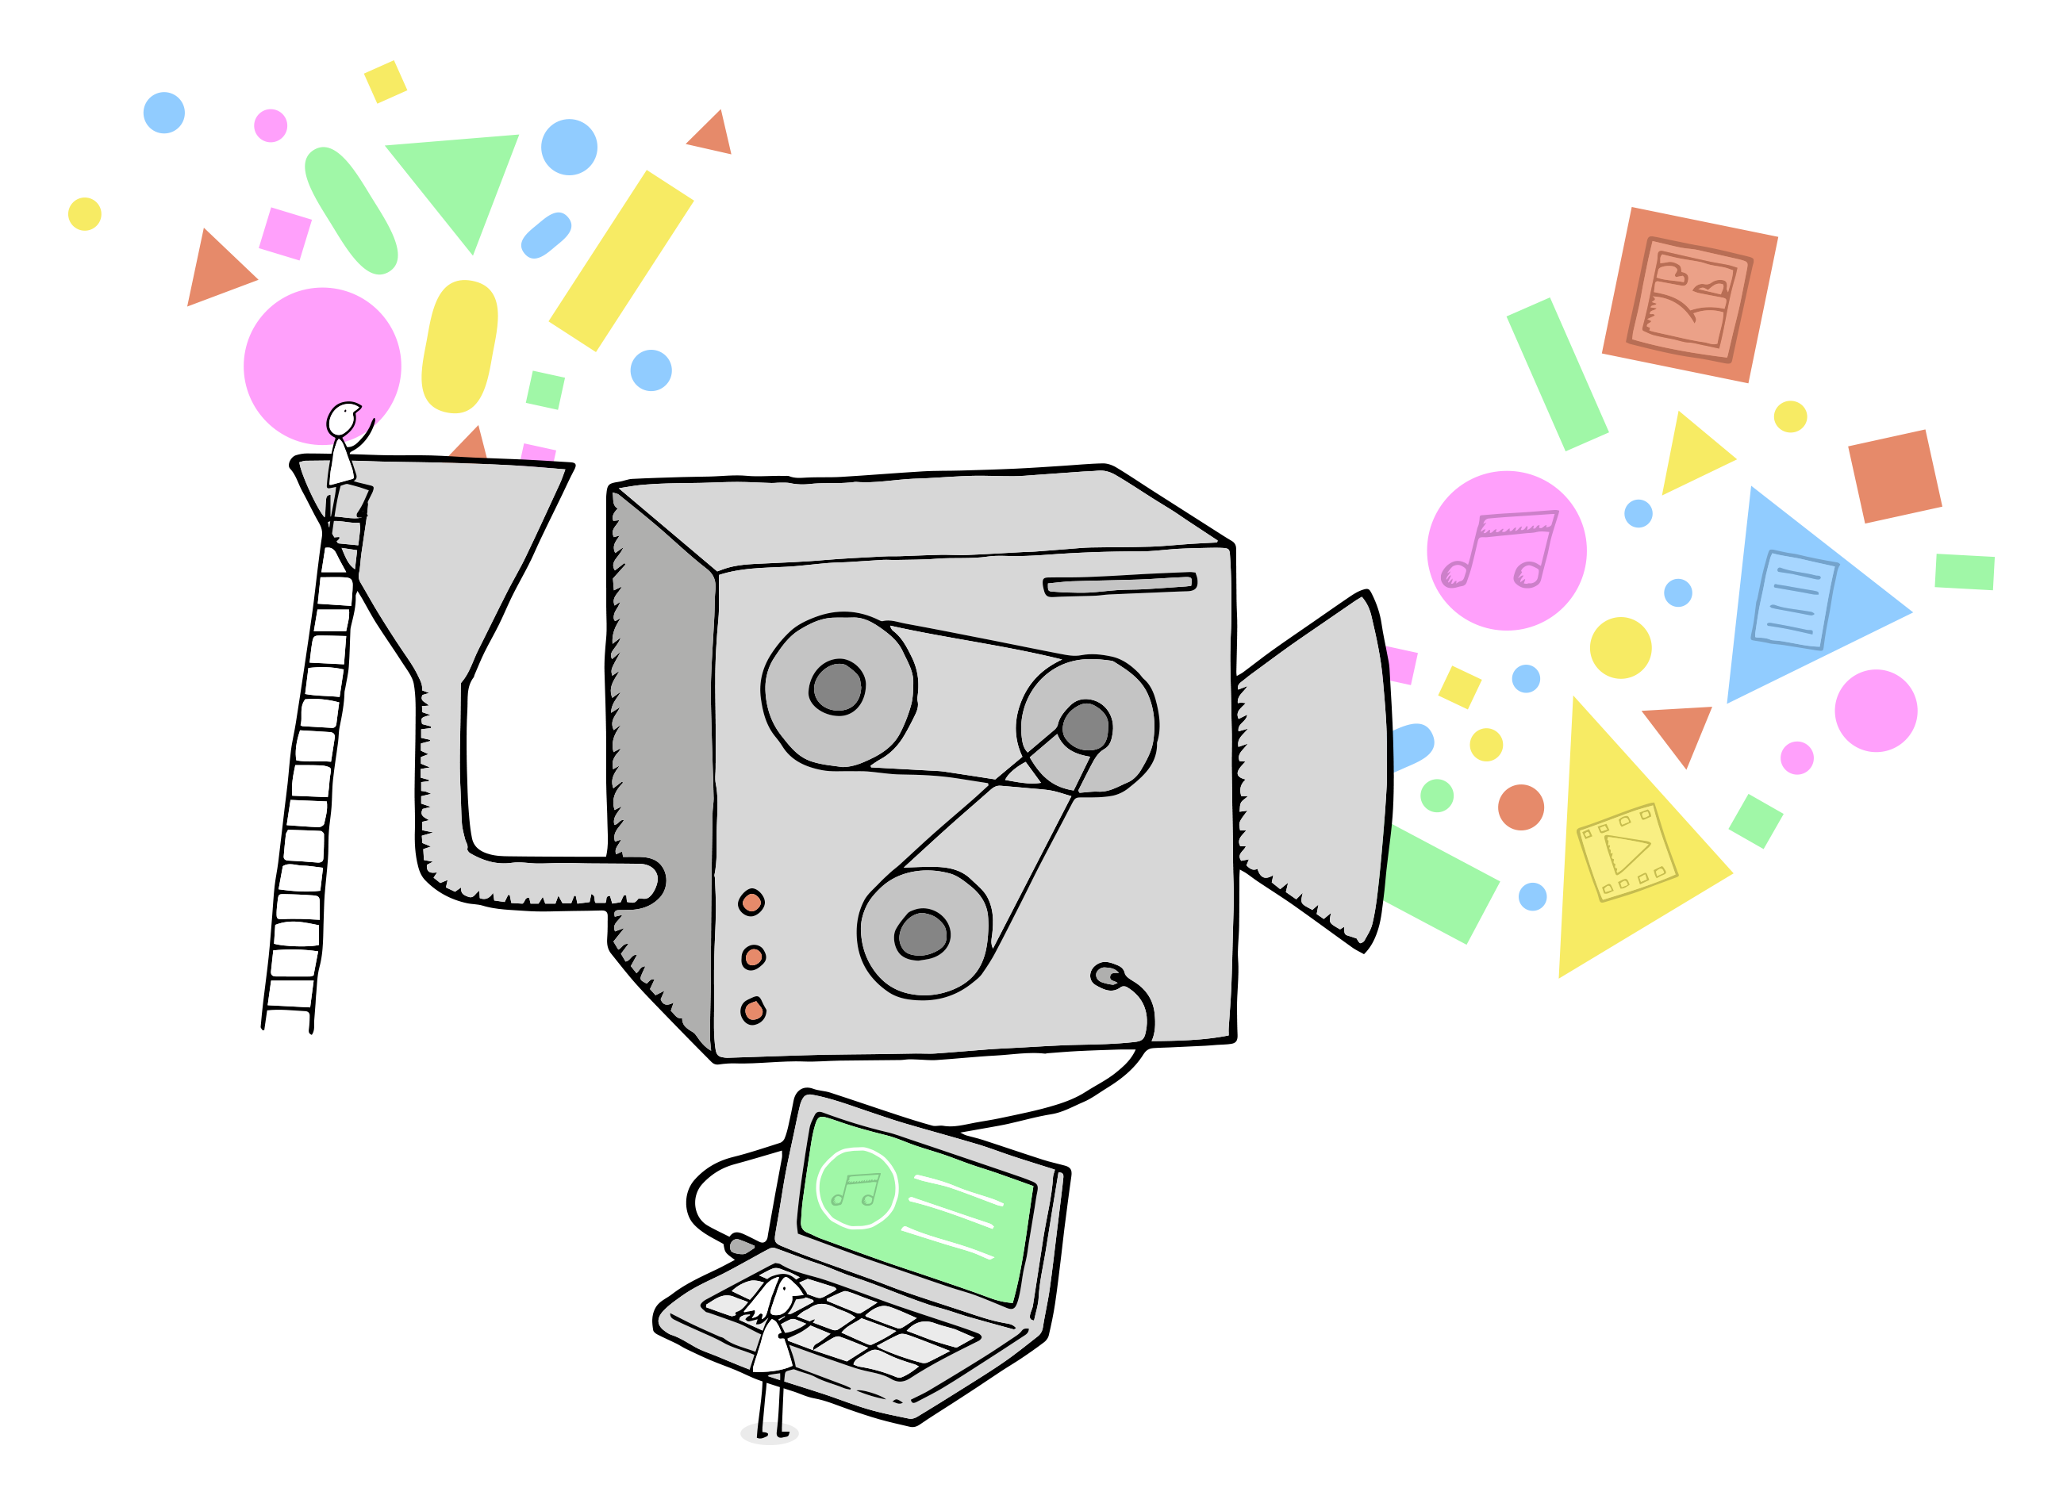
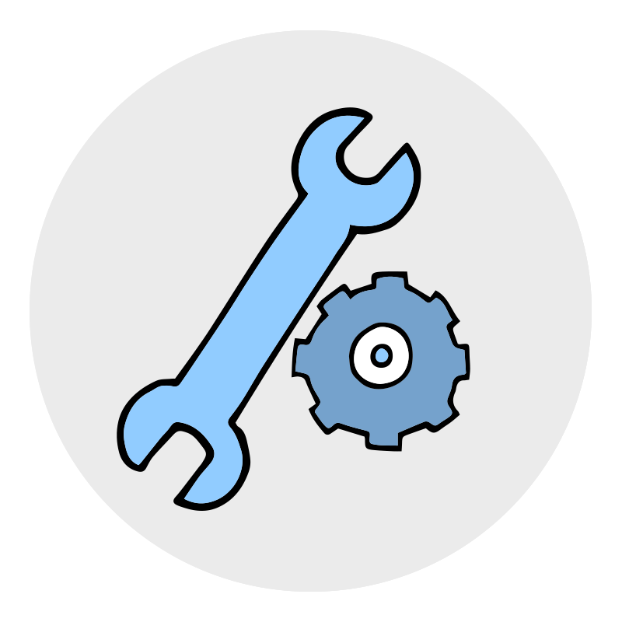
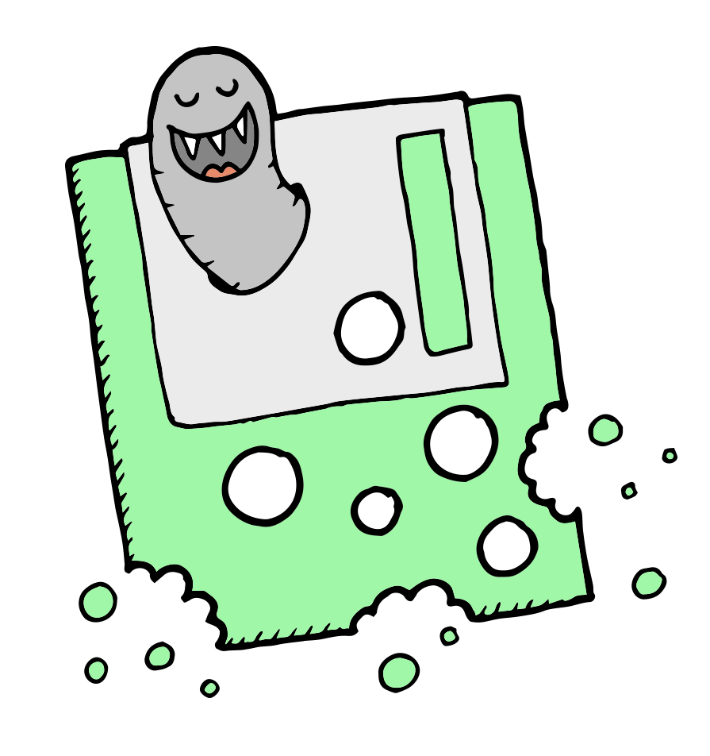
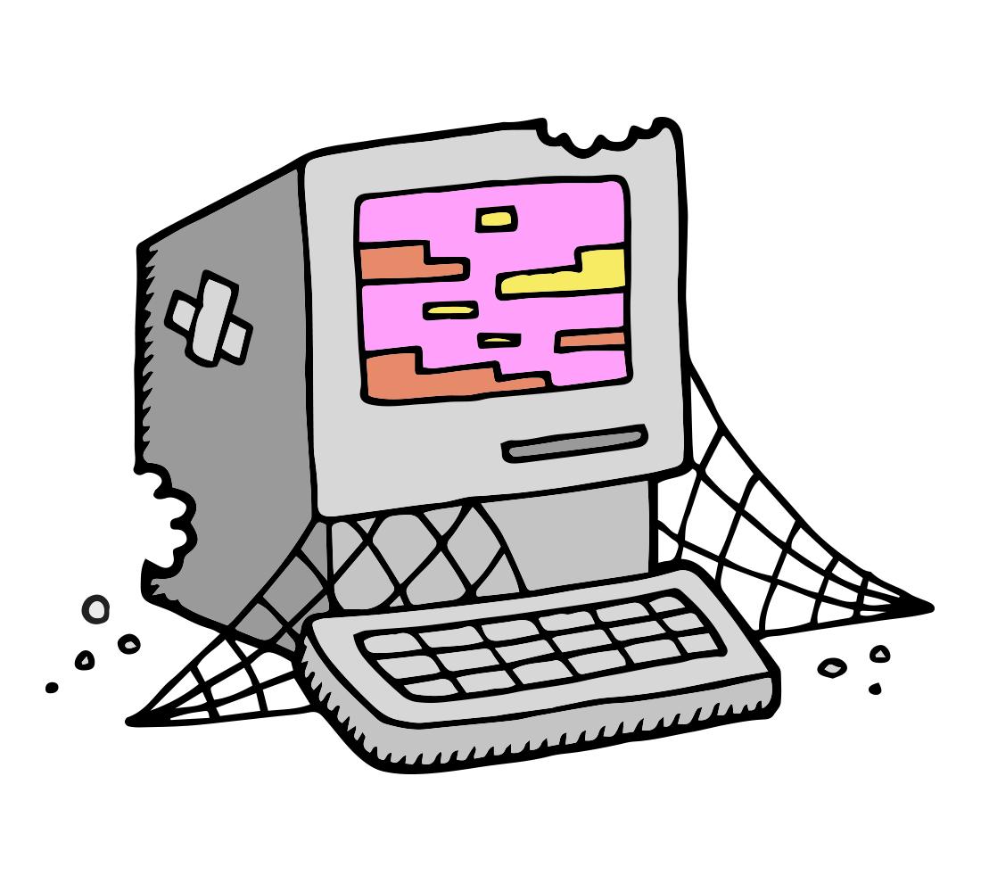
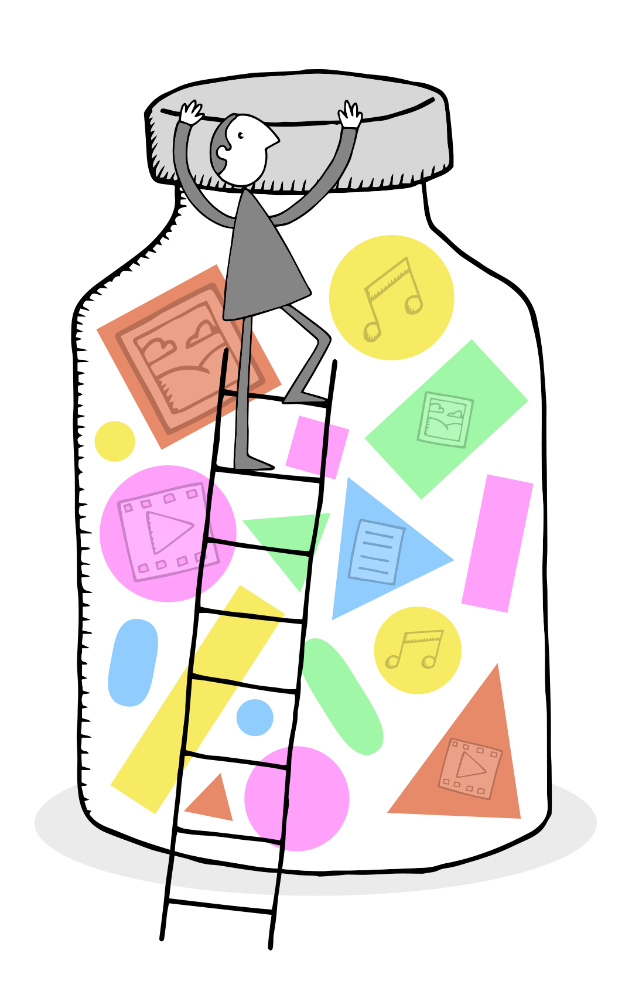
Lifecycle of Digital Stewardship

Slide 43
Part VIII:
Best Practices for the Digital Afterlife

Slide 44
What to Consider When Giving Personal Digital Records to Family/Heirs
Create a summary description of the files
Create intelligent file names that include date, location, and context
Use open formats (PDF, TIFF, JPEG)
Provide 2 copies in 2 different formats that can be maintained in 2 separate locations
Keep in stable and moderate temperatures
Create new media copies every 5 years to prevent data loss
Pass along digital passwords
Library of Congress on Personal Digital Archiving: http://digitalpreservation.gov/personalarchiving/

Slide 45
What to Consider When Giving Personal Digital Records to an Institution (Archives, Library, etc.)
Create a summary description of the files
Create intelligent file names that include date, location, & context
Remove inappropriate material
Use open formats (PDF, TIFF, JPEG)
Society of American Archivists guide, “Donating Your Personal or Family Records to a Repository”: http://www2.archivists.org/publications/brochures/donating-familyrecs
Council on Library and Information Resources report, “Born Digital: Guidance for Donors, Dealers, and Archival Repositories”: http://www.clir.org/pubs/reports/pub159/pub159.pdf

Slide 46
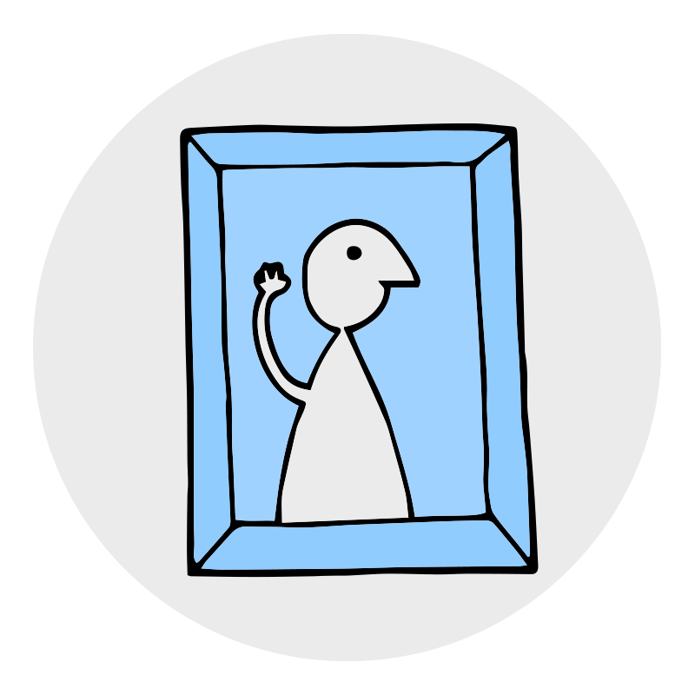
References
Wonderful illustrations courtesy of:
Tom Woolley, created for the "Digital Preservation Business Case Toolkit http://wiki.dpconline.org/ (Creative Commons Attribution-NonCommercial 3.0 Unported License)
Jørgen Stamp, created for www.digitalbevaring.dk (Creative Commons Attribution 2.5 Denmark license)

Slide 47
References
Google Dictionary. (2014). “Record.” http://www.google.com/search?q=define+record
Lee, C. (2014) "Digital Forensics Meets the Archivist (And They Seem to Like Each Other)," Provenance, Journal of the Society of Georgia Archivists: Vol. 30: Iss. 1, Article 2. http://digitalcommons.kennesaw.edu/provenance/vol30/iss1/2
Lee, C., Woods, K., Kirschenbaum, M., & Chassanoff, A. (2014). “From bitstreams to heritage: Putting digital forensics into practice in collecting institutions.” http://www.bitcurator.net/docs/bitstreams-to-heritage.pdf
Creative Commons. (2014). “Creative Commons: Choose a License.” http://creativecommons.org/choose/
Digital Public Library of America (DPLA). (2014). “Projects: Getting it Right on Rights.” http://dp.la/info/about/projects/getting-it-right-on-rights/

Slide 48
References
Bruckman, A., Fiesler, C., & Georgia Institute of Technology Institute Communications. (2014, April 18). “Do You Read Terms of Service? Maybe You Should.” http://www.news.gatech.edu/2014/04/18/do-you-read-terms-service-maybe-you-should
Wikimedia Foundation. (2014, July 23). “Comparison of online backup services.” Wikipedia. http://en.wikipedia.org/wiki/Comparison_of_online_backup_servicesBradley, T. (2012, January 29).
“Need More Storage? Expand with External Drives.” PCWorld. http://www.pcworld.com/article/248921/need_more_storage_expand_with_external_drives.html
Citizen Web. (2014). "3.1 – Why a Personal Server?." The CitizenWeb Project. https://citizenweb.is/guide/srv/1-why
Blackbrick. (2014). "Personalserver.com: The Future of Personal Computing." https://www.personalserver.com/web/en/home

Slide 49
References
Archivematica. (2014, April 1). "Format policies." https://www.archivematica.org/wiki/Format_policies
Library of Congress. (2014). "Recommended Format Specifications." http://www.loc.gov/preservation/resources/rfs/
Library of Congress. (2014). “Personal Digital Archiving.” http://digitalpreservation.gov/personalarchiving/
Society of American Archivists, Manuscript Repositories Section. (2013). “Donating Your Personal or Family Records to a Repository.” http://www2.archivists.org/publications/brochures/donating-familyrecs
Redwine, G., Barnard, M., Donovan, K., Farr, E., Forstrom, M., Hansen, W., John, J. L., Kuhl, N., Shaw, S., & Thomas, S. “Born Digital: Guidance for Donors, Dealers, and Archival Repositories.” Council on Library and Information Resources. http://www.clir.org/pubs/reports/pub159/pub159.pdf

Slide 50
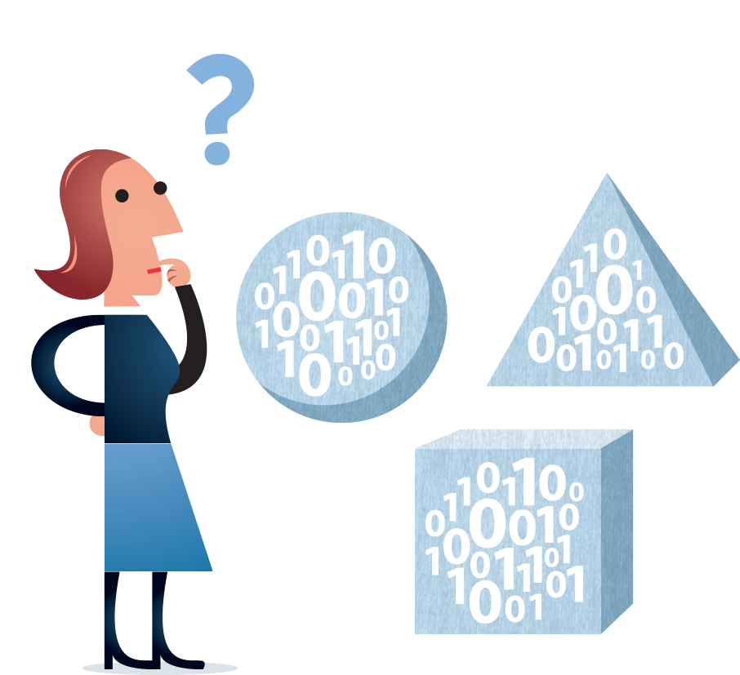
Questions?

Slide 51
Activity
Intro

Slide 52
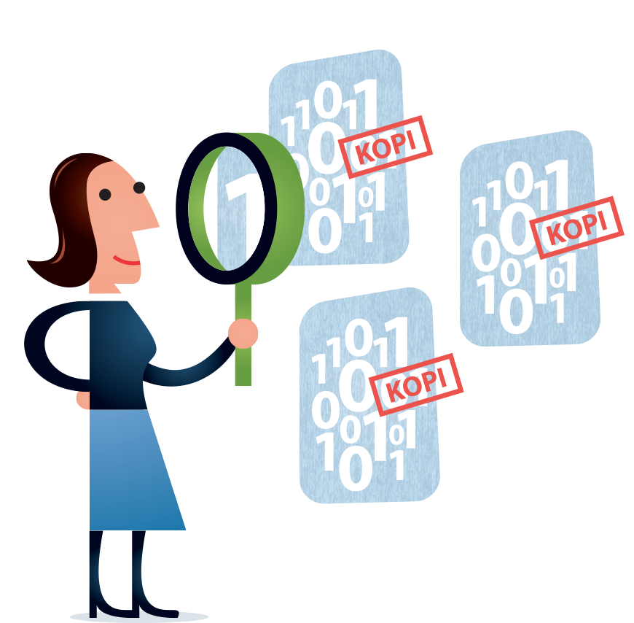
Activity:
Find the Person in the Personal Digital Archive: Murder Mystery Edition! (25 minutes)

Slide 53
Activity:
Small Group Reflection and Discussion about Personal Digital Archiving (10 minutes)

Slide 54
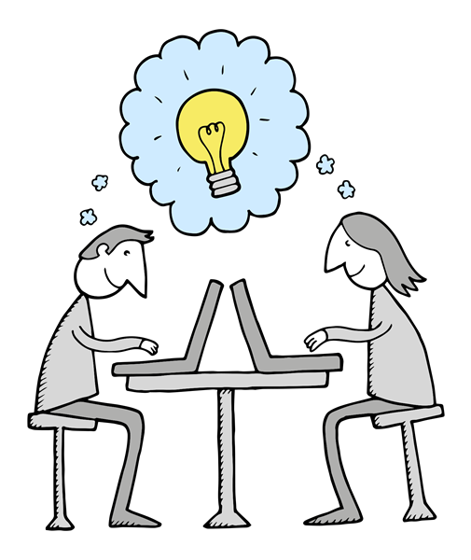
Activity:
Large Group Sharing and Discussion (10 minutes)

Slide 55
Wrap Up:
Invitation to Host Workshop and Complete Survey

Slide 56
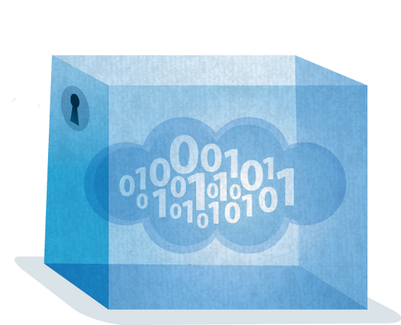
Thank you!
And best of luck with your personal digital archiving…

